Slide 1


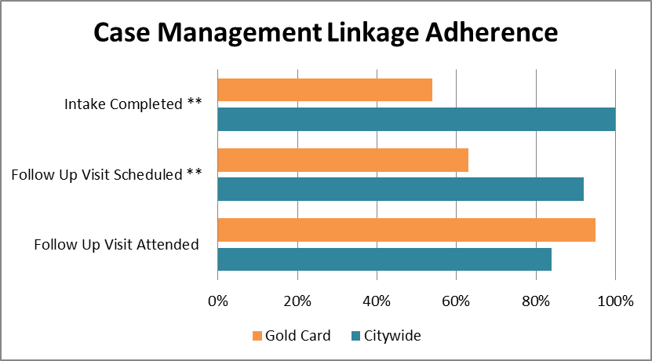
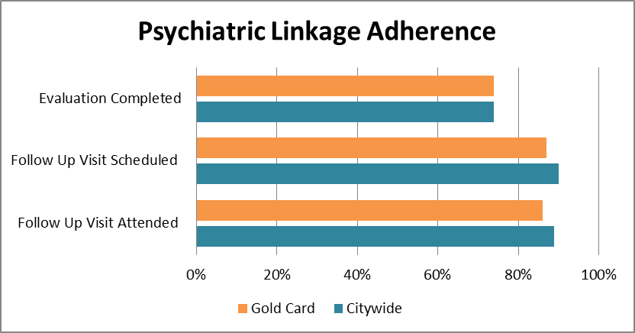



Evaluation of patient factors and strategies to improve linkage between outpatient and inpatient psychiatric services
NR1-035
Megha Miglani, MD, Emily Martin, BA, Jaspreet Uppal, BS, Steven Wozniak, MD, Christina Mangurian, MD, James W. Dilley, MD, Martha Shumway, PhD
University of California, San Francisco and San Francisco General Hospital
Background
Unsuccessful linkage of psychiatric inpatients to outpatient mental health care has been a long-standing issue affecting both the public and private sectors (1-3). Prior research estimates that 22-90% of inpatients fail to connect with outpatient services (1,4).
Mental health administrators and researchers have focused on predictors of readmission as well as linkage strategies because nonadherence greatly increases the risk of rehospitalization and relapse (5). Unfortunately, most studies of factors related to linkage as well as studies of strategies to improve outpatient follow-up are more than 10 years old.
Some previously identified patient-specific factors include age, diagnosis, sex, legal status, co-morbid substance use, and length of stay (1-3, 6). Identified potential effective bridging strategies include: communication between inpatient and outpatient staff, inpatients starting an outpatient program prior to discharge, family involvement, and critical time interventions (1, 7). Given the ongoing struggles with linkage, it may be useful to examine linkage of patients who have participated in some of these identified bridging strategies.
Objectives
Determine patient-specific factors associated with linkage and adherence to outpatient care
Evaluate and compare current bridging strategies linking discharged psychiatric inpatients with an outpatient community clinic
Sample Characteristics
❻
❺
Results:
Case Management Linkage and Adherence
Summary:
Patients with Citywide Linkage case management were much more likely to have their intake completed in the clinic than patients with the “Gold Card” discharge plan (100% vs. 54%)
After completing the intake, Citywide Linkage patients were much more likely to have an initial follow up appointment scheduled than “Gold Card” patients ( 92% vs. 63%)
However after having the follow up appointment scheduled, Citywide Linkage patients attended the appointment about as frequently as “Gold Card” patients ( 84% vs. 95%)
❼
Conclusions
Citywide linkage clients were significantly more likely to complete intake with a case manager because it took place in the inpatient unit
Successful linkage to outpatient psychiatric care was largely determined by attendance at the first intake appointment.
Both bridging strategies had high levels of engagement after initial appointments with an 85-90% attendance at follow-up appointments.
Despite engagement, only 20% of individuals had open charts after 6 months of treatment; 15% of Citywide Linkage patients and 22% of clients with a “gold card.”
Bridging strategies did not affect utilization of acute services post hospitalization.
Study limitations include small sample size in a homogenous high risk patient population with many homeless, uninsured, non-working individuals; thus, results may not be generalizable in other settings.
❶
❷
Results:
Psychiatric Linkage and Adherence
Summary:
Patients with Citywide Linkage case management were about as likely to have their psychiatric evaluation completed in clinic as patients with the “Gold Card” discharge plan (74% vs. 74%)
After completing the intake, Citywide Linkage patients were about as likely to have an initial psychiatric follow up appointment as “Gold Card” patients ( 90% vs. 87%) and about as likely to attend the follow up appointment (89% vs. 86%)
❾
Methods
Subjects: Psychiatric inpatients from San Francisco General Hospital (SFGH) who are not connected with outpatient psychiatric services and were discharged to a community clinic, South of Market Mental Health Services (SOM MHS). Patients were discharged into either a case management program (n= 27) or provided with a “gold card” discharge plan (n=59) arranged by inpatient and outpatient staff to facilitate immediate access to outpatient care.
Study Type: Retrospective chart review
Study Procedure: The electronic records for SFGH psychiatry inpatients were reviewed for discharges between 7/1/2012 and 6/30/2013. Demographic and other patient-specific variables previously identified in the literature were collected. In addition, information on no-shows, cancelled appointments, chart closures, crisis visits, re-hospitalizations were also collected to evaluate adherence.
Data Analysis: Chi square tests and t-tests were used to examine the impact of bridging strategy (case management vs. "gold card”) and patient factors on linkage and adherence to outpatient care.
❸
Two Bridging Strategies:
1) Citywide Linkage Case Management:
Short-term assertive case management program
Clinician engages patients during hospitalization
Clinician follows patients until they link to ongoing mental health services
2) “Gold Card” Discharge Plan:
Communication between inpatient and outpatient staff
Immediate assignment of outpatient clinician
Scheduled intake appointment and medication evaluation within 5 days of discharge
References
10
Results
1. Boyer, CA, McAlpine DD, Pottick KJ, et al: Identifying risk factors and key strategies in linkage to outpatient psychiatric care. American Journal of Psychiatry 157:1592-1598, 2000
2. Cuffel, BJ, Held M, Goldman W: Predictive models and the effectiveness of strategies for improving outpatient follow-up under managed care. Psychiatric Services 53:1438-1443, 2002
3. Compton, MT, Rudisch, BE, Craw, J, et al: Predictors of missed first appointments at community mental health centers after psychiatric hospitalization. Psychiatric Services 57:531-537, 2006
4. Boyer, CA: Meaningful linkage practices: challenges and opportunities. New Dimensions for Mental Health Services 73:87-101, 1997
5. Nelson, EA, Maruish, ME, Axler, JL: Effects of discharge planning and compliance with outpatient appointments on readmission rates. Psychiatric Services 51:885-889, 2000.
6. Stein, BD, Kogan, JN, Sorbero MJ, et al: Predictors of timely follow-up care among Medicaid-enrolled adults after psychiatric hospitalization. Psychiatric Services 58:1563-1569, 2007
7. Dixon, L, Goldberg, R, Iannone, V, et al: Use of a critical time intervention to promote continuity of care after psychiatric inpatient hospitalization 60:451-458, 2009
8. Photograph of San Francisco General Hospital by Richard Castro
❽
Pre and Post Admission Acute Services Utilization:
Citywide Linkage patients and Gold Card patients showed no significant differences between acute services utilization either pre or post admission.
Setting
Founded in 1872, San Francisco General Hospital (SFGH) is an essential part of San Francisco’s health care system. It serves some 100,000 patients yearly and is considered one of the finest public hospitals in the country. Owned by the San Francisco Department of Public Health and partnered with UCSF since its inception, SFGH provides integrated and innovative patient care to the San Francisco community.
South of Market Mental Health Services is a community mental health clinic within the San Francisco Department of Public Health. It primarily serves adult residents of the Tenderloin, Western Addition and South of Market neighborhoods and is unofficially known as the “homeless” mental health clinic in San Francisco.
❹
Acute Services:
Emergency psychiatry visits
Additional psychiatric inpatient hospitalizations
Admissions to Acute Diversion Units (step-down psychiatric units)
Psychiatric urgent care visits
This work was supported by the San Francisco Department of Public Health, Community Behavioral Health Services.

